Slide 1
RoverArm

Slide 2
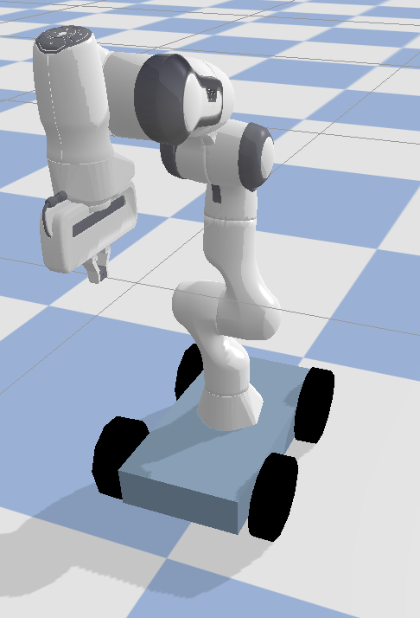
Robot Design and Action Space
Action Space
Box(low = [-1] * 6, high = [1] * 6)
Rover Actions – Throttle, Steer
Arm Actions – dx, dy, dz, f
dx, dy, dz – change in co-ordinates of end effector
f – fingers location

Slide 3
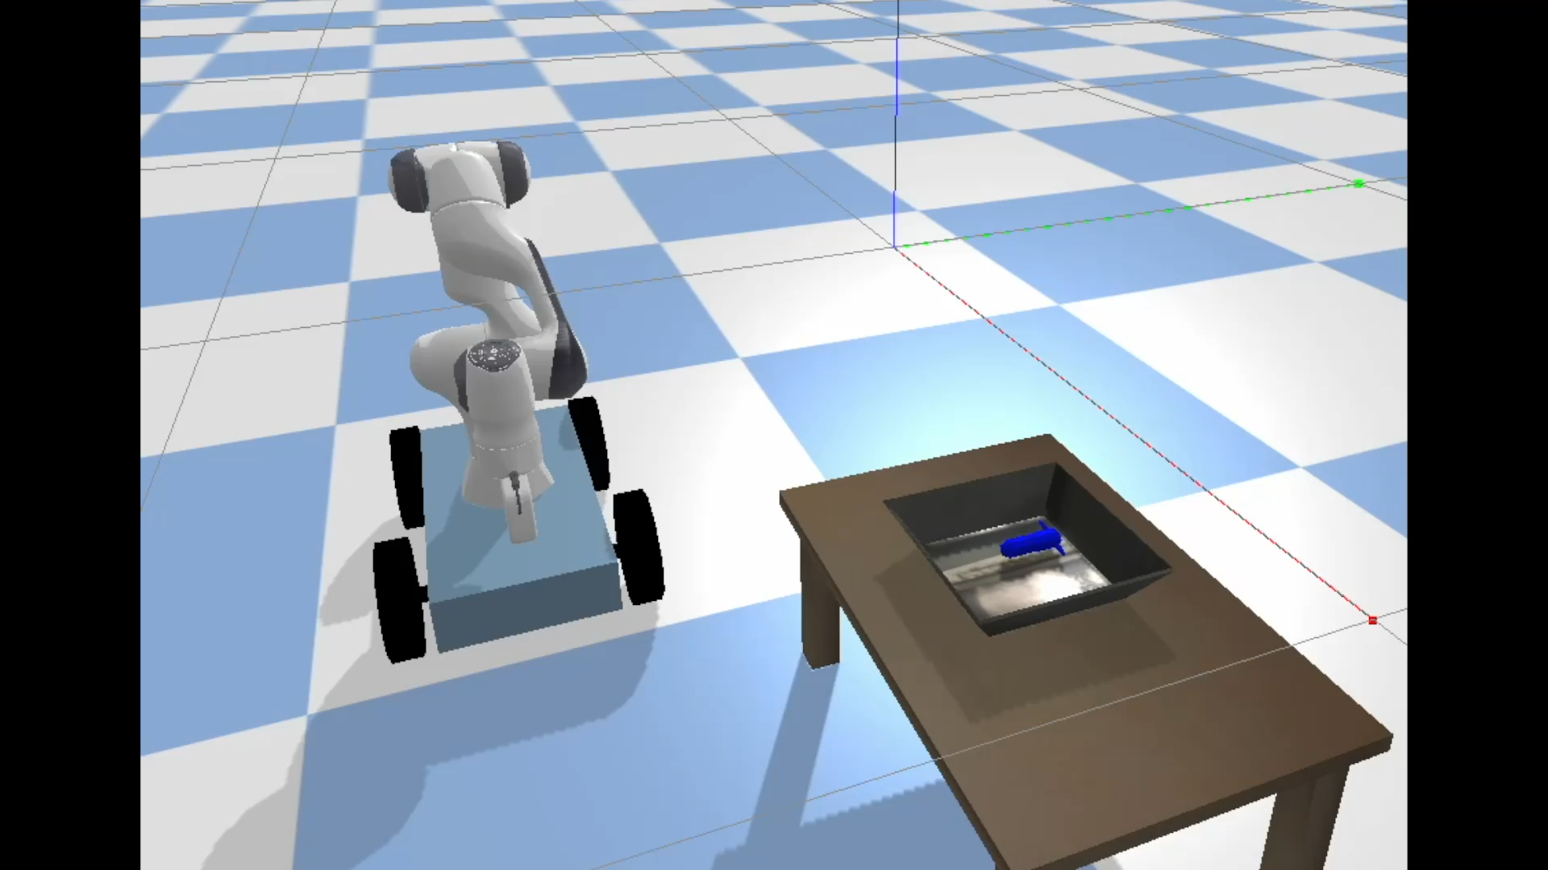
Task1
Pick up the object
Reward
Once the object is held by bot and raised to some height, reward = 1
Unless the object reaches that state, reward = 0

Slide 4
Observation Space
Box(low = [-b, -b, -x,-y,-z, 0,0], high = [b,b, x,y,z, f,f ] )
b - boundary within which the rover can move on the plane.
x,y,z – Coordinates of the end effector of the arm.
f – maximum distance the finger of arm can move.
Info – contains the location of the objects on tray.

Slide 5
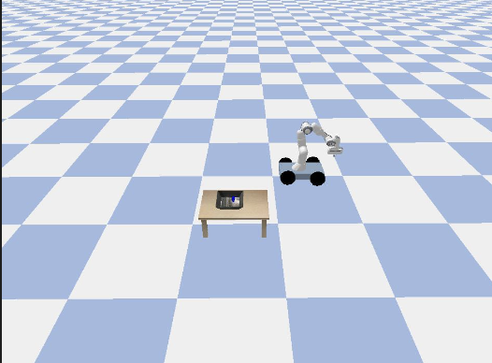
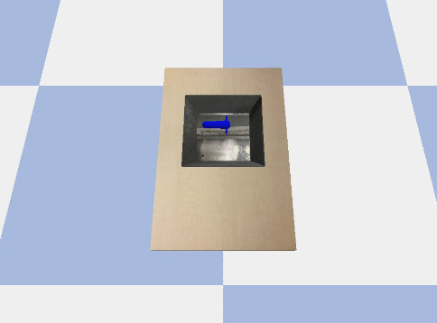
Observation Space
Images from two cameras are passed to model, one for front view of scene, and one for top view of the tray.

Slide 6
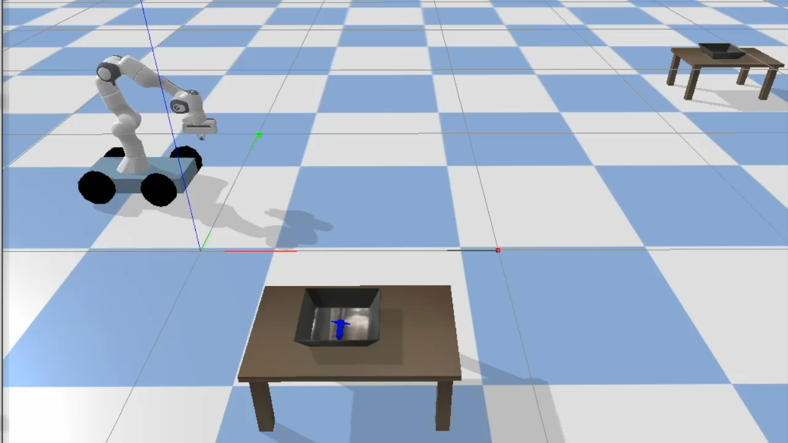
Task2
Pick up the object (from the tray that is closest to camera) and place it on the second tray (the one that is far away).

Slide 7
Reward Mechanism
Once the object lies within co-ordinates of second tray, we could say the task is complete and bot gets the reward.

Slide 8
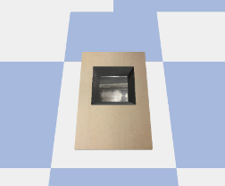
Observation Space Update
All the inputs mentioned for Task1, and additionally, an image of output tray is also passed to model.

Slide 9
Task3
Pick up the object (from the tray that is closest to camera) and place it on the second tray (the one that is far away) in given position.
Input image containing target placement of object in the tray is passed to the model.

Slide 10
Reward Mechanism
We can segment the object’s location on input image and final placement, once the distance of center pixel of objects are less than a threshold, we could say the task is complete and bot gets the reward.

Slide 11
Task4
Task3 with Multiple Objects.
Input image containing target arrangement of objects in the tray is passed to the model.

Slide 12
Reward Mechanism
We can get segment the location for each object on input image and final placement, once the distance of center pixel of every object is less than a threshold, we could say the task is complete and bot gets the reward.

Slide 13
Algorithms
DQN with Discrete Actions
REINFORCE
Actor Critic
Probably,
Model based learning
Imitation Learning

Slide 14
Strategies
Run the bot using controller / keyboard manually, get training data so that the model would have training data where the end goal is reached.
Notes:
(with DQN this is possible, need to figure out for other algos)

Slide 15
Code
GitHub Repo https://github.com/Saiphani724/RoverArm
PyPI Package https://pypi.org/project/rover-arm/1.0.0/

